Slide 1
The Red Flag Project

Slide 2
The Red Flag Project
YouTube Link - https://youtu.be/J-03uUVYZmc

Slide 3
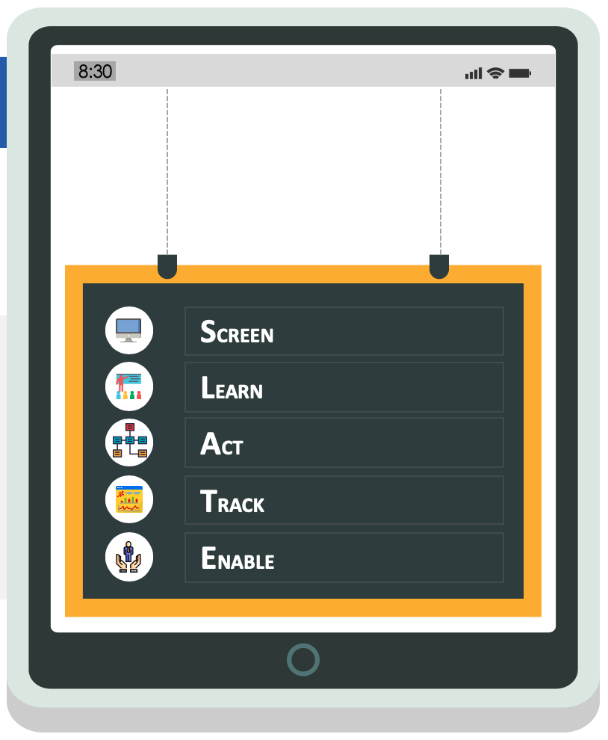
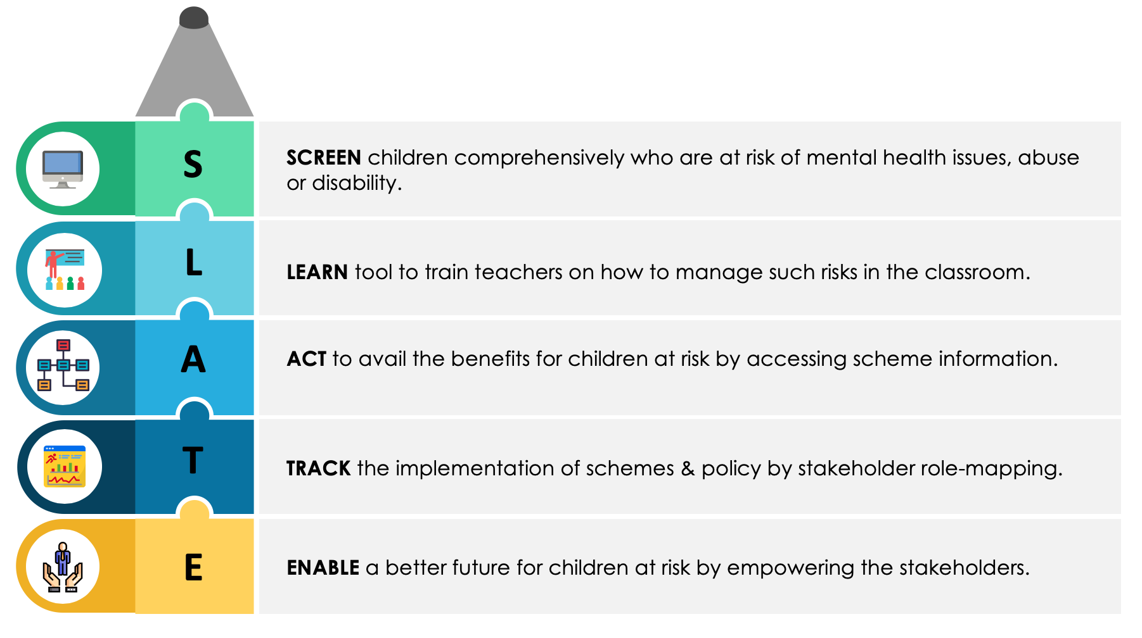
The Red Flag App Features

Slide 4
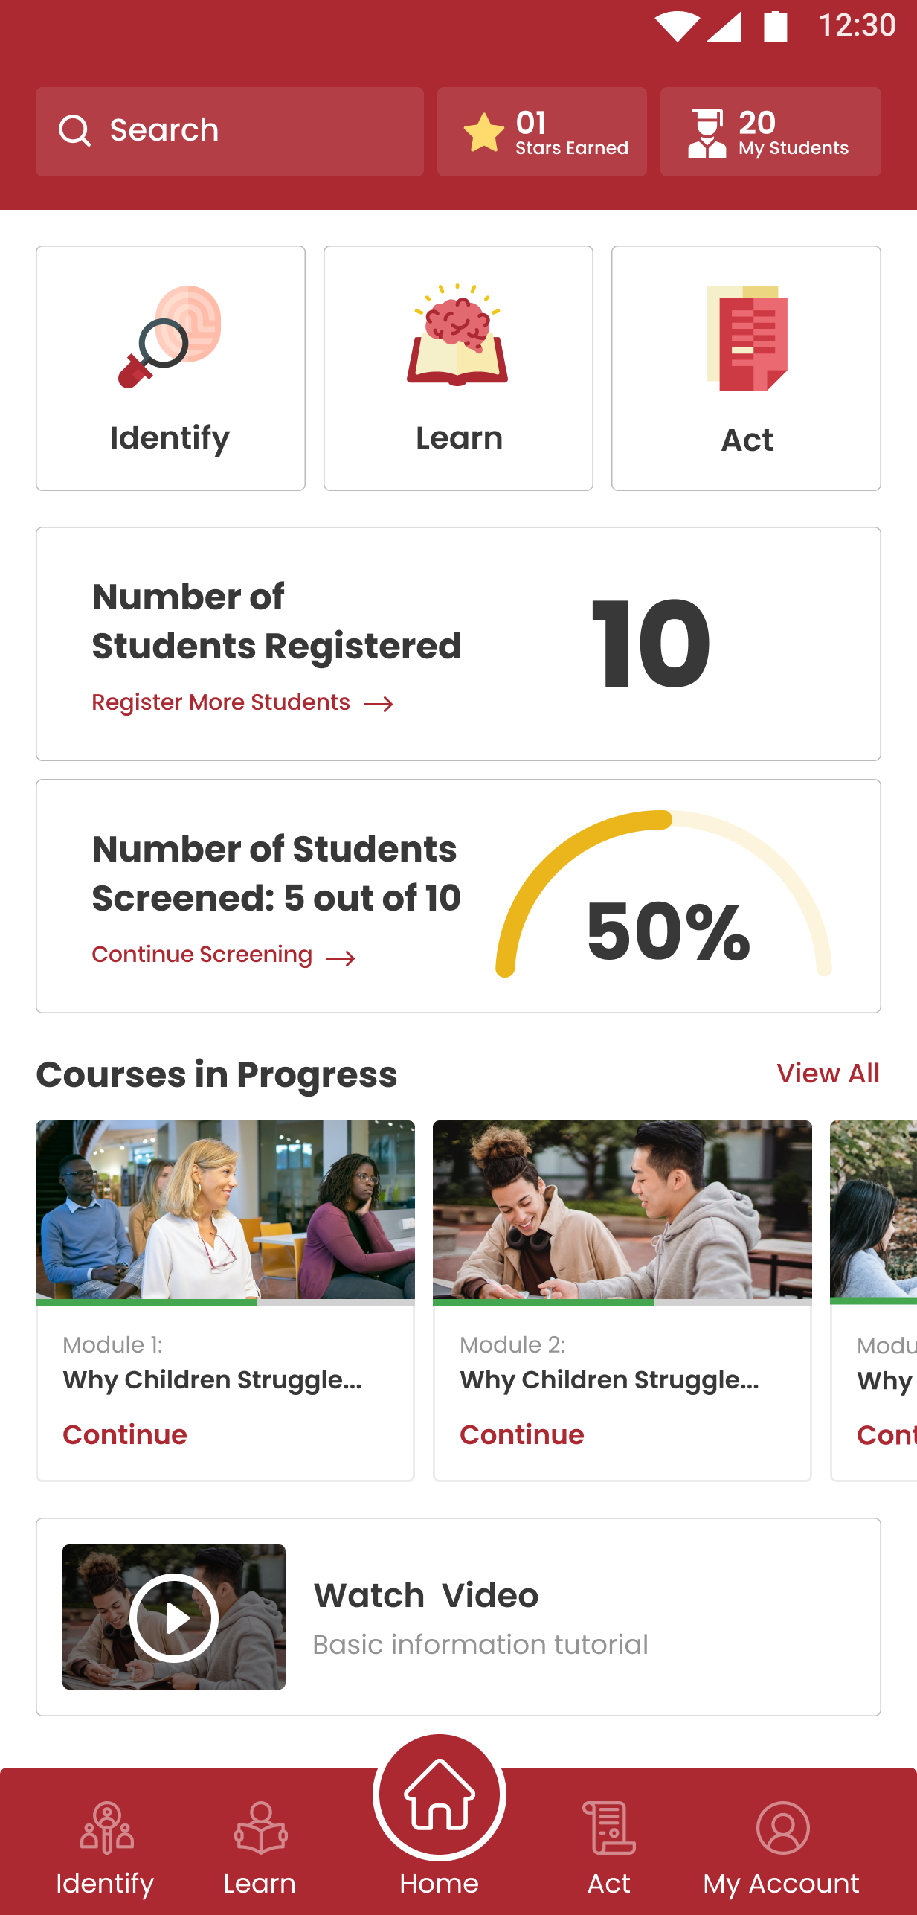
Home Screen
Home Screen
Key Features
Navigations to different sections
Dashboard with the data
Ongoing courses
User –
Mainstream Teachers
Special educators
Therapists

Slide 5
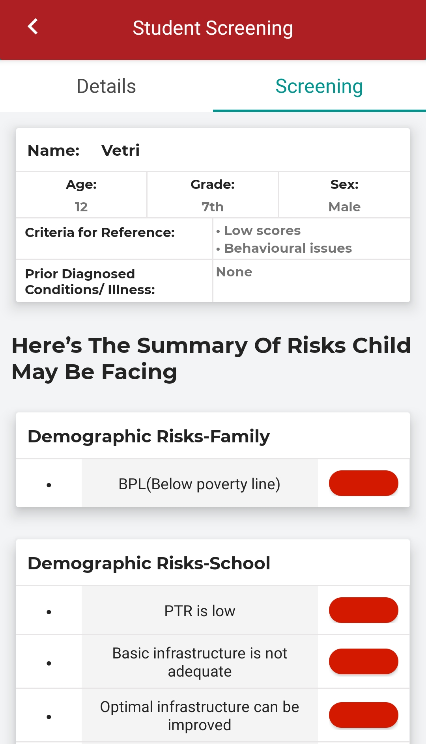
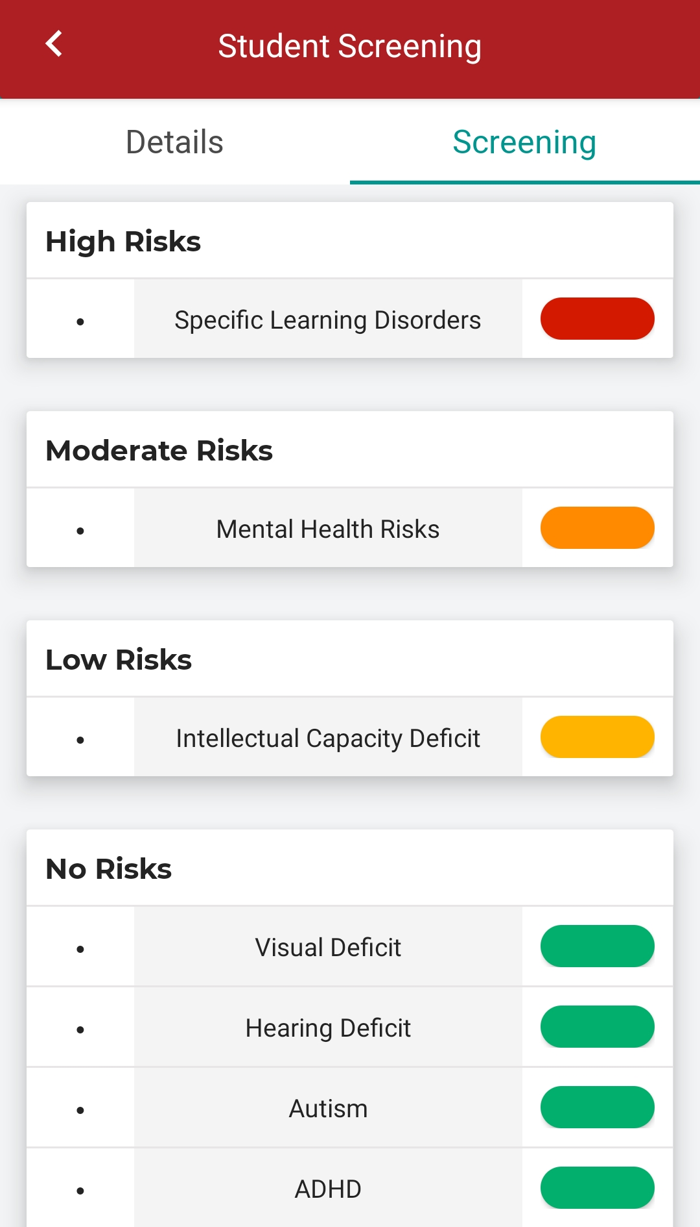
Screen Section
Key Functions
Screens for Multiple Risks
No Labelling
Teacher Led
Results provide Demographic risks for School & Family, Disability Risks and Risks for mental health challenges
Provides recommendations based on results that a teacher can immediately begin
Links to modules the teacher needs to learn from
Learning Deficits
Visual Deficit
Hearing Deficit
Communication and social difficulties
Attention Issues / Excessive Physical

Slide 6
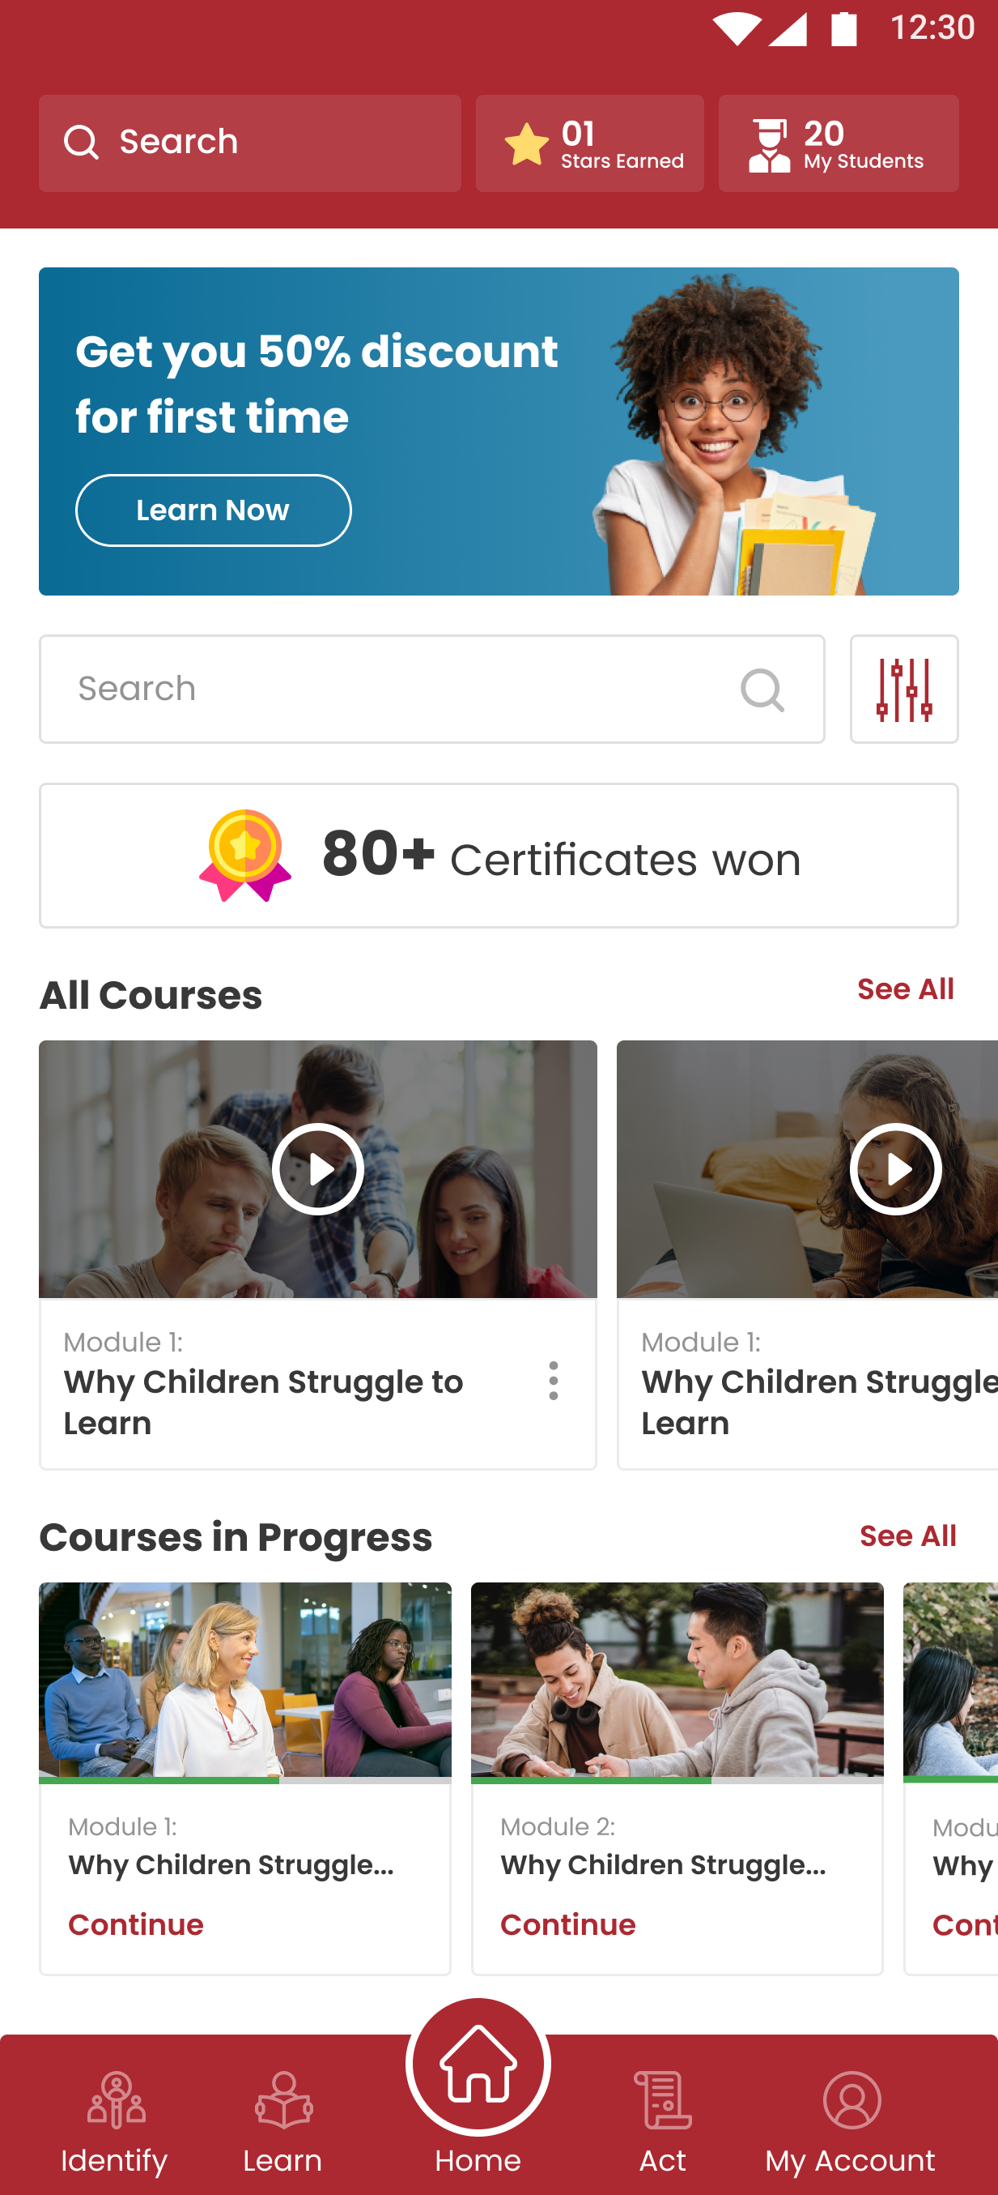
Learn Section
Key Functions
Teachers Learn at their own pace
and as per the requirement of the
identified children in the classroom
Teacher learns how to include children across different issues like Mental Health, Disability, Gender , Abuse etc.
The modules teach Inclusive strategies for class rooms, extracurricular activities like sports dance etc.
Knowledge check is provided through Pre and post assessments
Teachers are required to upload images & videos of inclusive practices they have used after training

Slide 7
Learn Section - Video Samples
YouTube Link - https://youtu.be/f329SI8r5TM

Slide 8
Learn Section - Video Samples
YouTube Link - https://youtu.be/kSL9yrNLlrU

Slide 9
Learn Section - Video Samples
YouTube Link - https://youtu.be/xzpjIKRTFKA

Slide 10
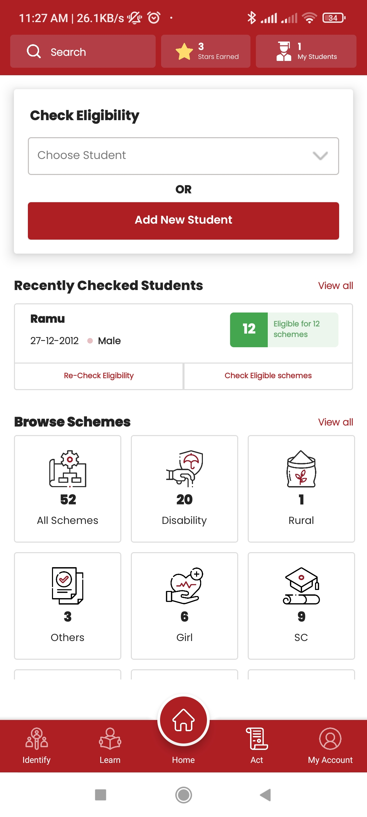
Act Section
Key Functions
Government Scheme
Schemes across multiple ministries across Vulnerabilities
Detailed information on how to apply
Remote Access
Connecting remotely via video calls with experts
Access to therapists in the remotest areas
Parent involvement & participation
Note – The remote access to experts is under development and not available currently

Slide 11
Pilot Study- 2020 - 2021
Objective of Pilot –
To establish the
reliability and validity of the app .
Location –
3 districts in Tamil Nadu - Kancheepuram, Theni and Villupuram
Pilot Sample –
1061 Government Teachers, Special Educator from 3 districts from 44 blocks
Pilot Methodology
Teachers were given 3 Case Studies to identify risks
Teachers were asked to list possible risks this child may be facing in the Google Form
Step 2: Training
Teachers used App to screen children using Case studies for risks
Teachers were trained to use the App
Step 1: Pre- assessment
Step 3: Post assessment

Slide 12
Pilot Study- 2020 - 2021
Overall, 76.8% teachers were able to correctly identify at least one case of disability during pre-assessment. In contrast, 88.9% teachers were able to correctly identify at least one case of disability during the post assessment phase.
Among the teachers who were unable to correctly identify any cases during pre-assessment, 80% were able to correctly identify at least 1 case during post-assessment.
Similarly, teachers who were able to correctly identify 1 case during preassessment, 52.5% were able to correctly identify 2 or more cases during the post-assessment.
Among the teachers who were able to correctly identify 2 cases during pre-assessment, 46.98% were able to correctly identify all 3 cases during post assessment.
Number of cases correctly identified | Pre-test n(%) | Post-test n(%)
0 | 246 (23.19%) | 118 (11.12%)
1 | 364 (34.31%) | 290 (27.33%)
2 | 315 (29.68%) | 286 (26.96%)
3 | 136 (12.81%) | 367 (34.59%)
Results published in the International Journal of Education

